Slide 1
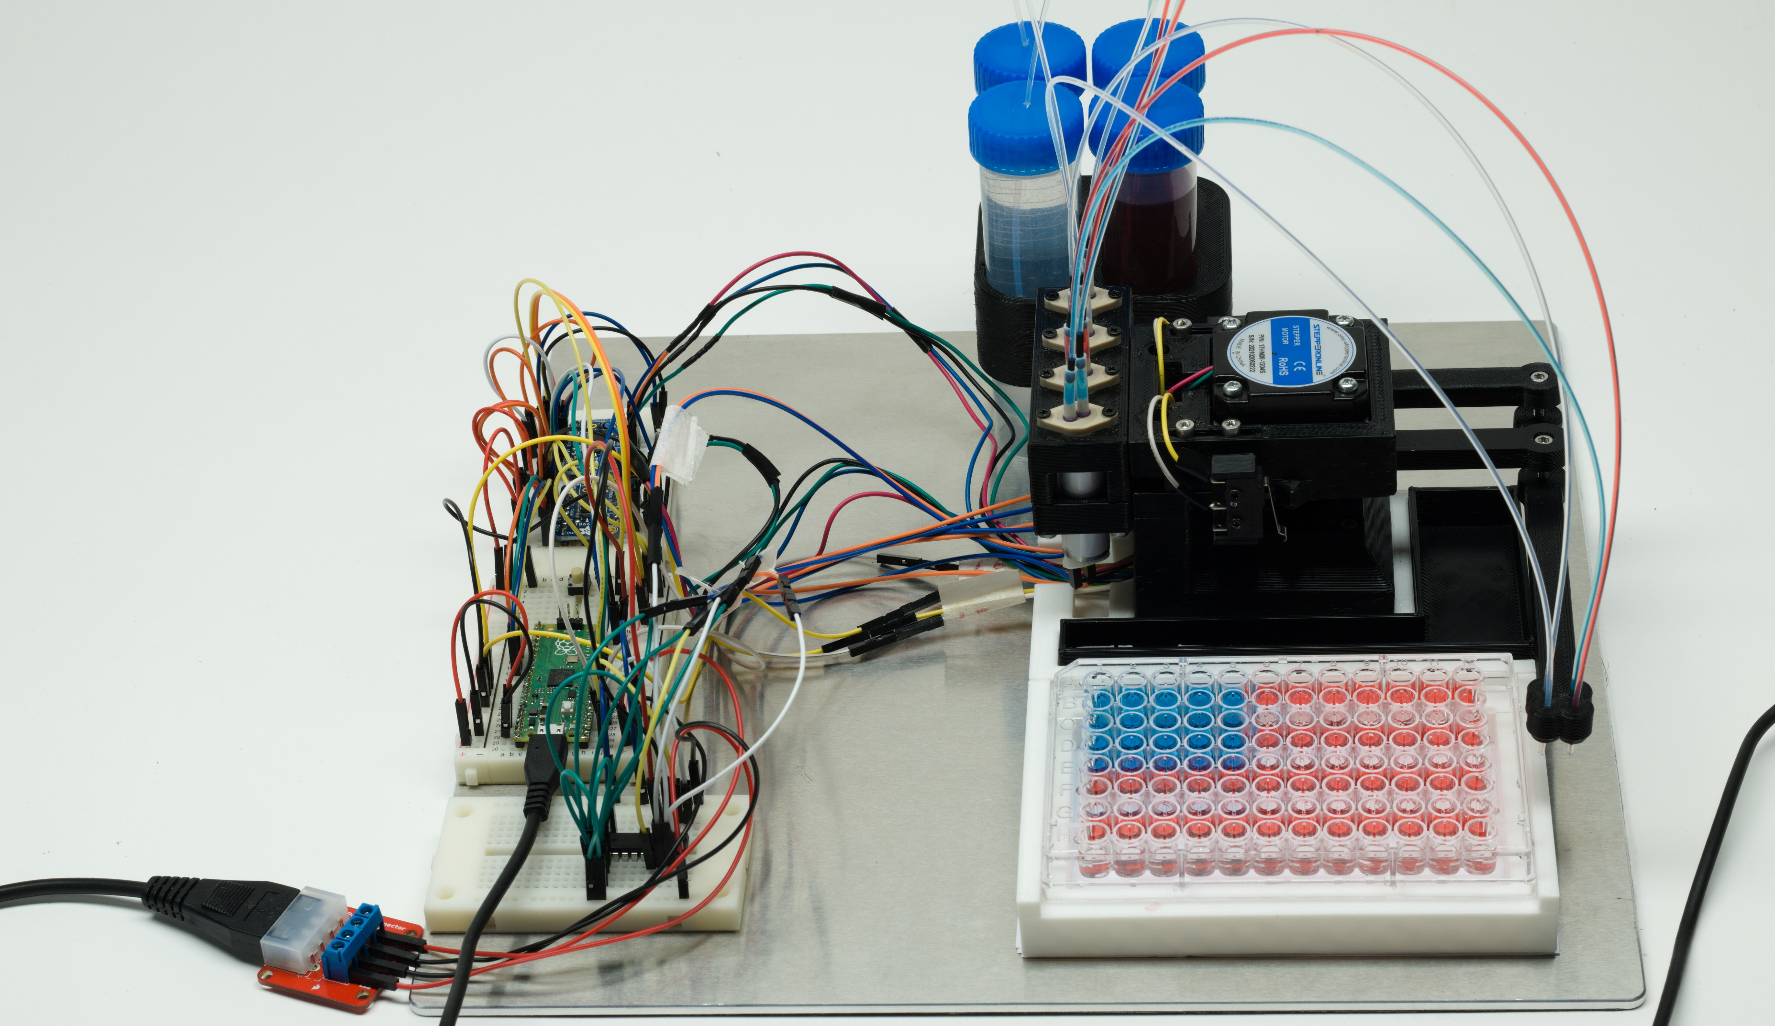
The “SideKick”
1/32” ID PTFE Tubing
The Lee Company Fixed Volume 10μL Dispense Pumps
(LPMA1250110L)
0.9 Degree NEMA-17 Pancake Stepper Motors
Adafruit Stepper Motor Drivers
(TB6612)
Raspberry Pi Pico
Darlington Array
(ULN2803A)
Limit
Switches
USB Cable
12V/5V Power Supply

